Slide 1

MUTUAL FUND ANALYTICS CAPSTONE PROJECT
Bluestock Fintech Internship Portfolio
Comprehensive Data Engineering & Financial Analysis of Indian Mutual Fund Schemes

Slide 2







Problem Statement & Objectives
The Challenge
Strategic Goals
Key Deliverables
Financial advisors and retail investors struggle with fragmented Mutual Fund data and lack of automated tools for multi-metric performance comparison.
Develop an automated ETL pipeline to ingest NAV data, perform advanced risk-return analytics, and visualize insights for informed decision making.
Cleaned dataset, performance metrics dashboard, and automated reporting system for 500+ active Mutual Fund schemes.

Slide 3
Data Sources & Acquisition
Source Entity | Data Type | Delivery Method | Frequency
AMFI India | Scheme Master, NAV Records | CSV / Text Exports | Daily (EOD)
RapidAPI (MF) | Historical NAV Trends | JSON via REST API | Ad-hoc / Batch
Yahoo Finance | Benchmark (Nifty 50) Data | Python (yfinance) | Real-time / Historical
Internal DB | User Preferences & Portfolios | PostgreSQL | Event-driven

Slide 4

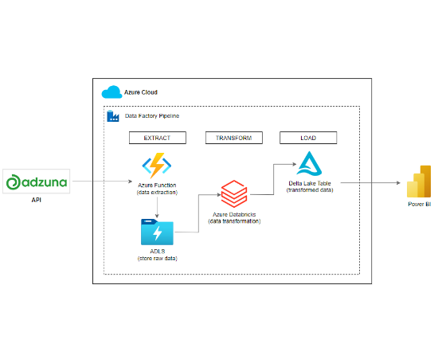
ETL & Technical Architecture
Our robust pipeline follows the Medallion Architecture to ensure data integrity and scalability.
Extraction: Python scripts fetch data from AMFI and APIs using asynchronous requests.
Transformation: Pandas-based cleaning for NAV nulls and schema mapping.
Load: High-performance staging in PostgreSQL for analytical queries.
Consumption: Power BI & Tableau Public for real-time visualization.

Slide 5
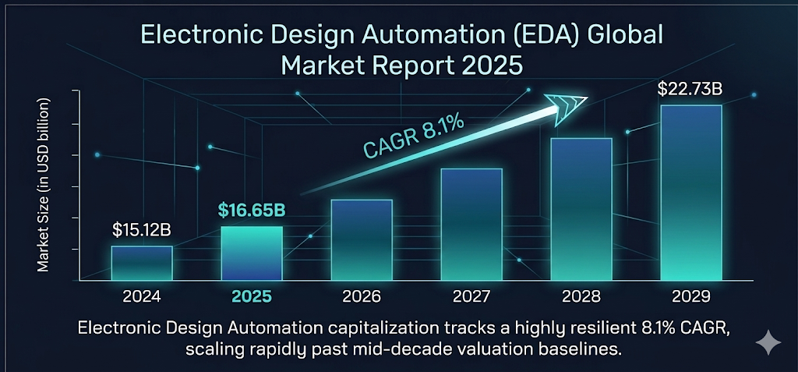

EDA: Market Performance Trends

Slide 6
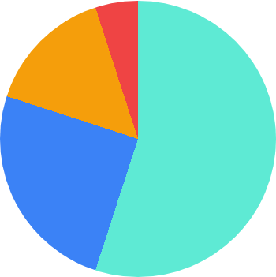
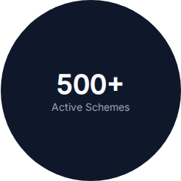
EDA: Asset Category Distribution
Equity (55%): Dominated by Mid-cap and Flexi-cap funds.
Debt (25%): Liquid and Corporate Bond funds show highest stability.
Hybrid (15%): Aggressive balanced funds gaining traction.
Others (5%): ETFs and Gold funds.

Slide 7




Risk-Adjusted Return Metrics
Alpha
Beta
1.24 Avg. Sharpe Ratio
+3.2%
0.85
A Sharpe Ratio > 1.0 indicates that the fund provides higher returns for each unit of risk compared to risk-free treasury instruments.
Excess return vs Benchmark
Market Volatility Sensitivity
Std Dev
R-Sq
12.4%
94%
Historical Price Volatility
Correlation with Index

Slide 8
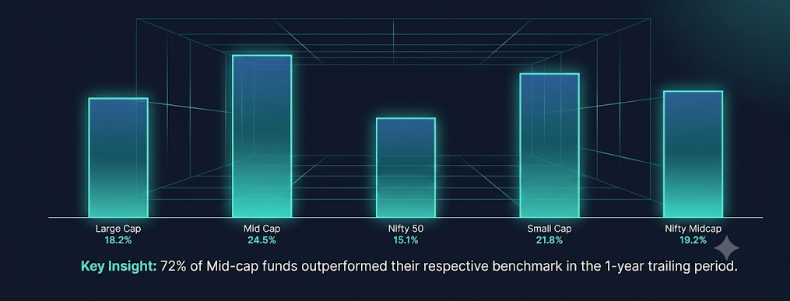
Fund Category vs. Benchmark Index

Slide 9

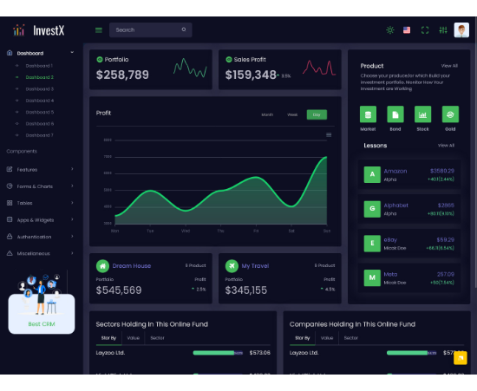
Executive Overview Dashboard
Holistic Insights
The primary dashboard provides a unified view of market liquidity, category-wise AUM, and top/bottom performers.
Real-time Tickers: NAV updates for starred funds.
Dynamic Filtering: Slice by AMC, Risk Grade, or Expense Ratio.
Comparative Charts: Instant side-by-side fund comparison tool.

Slide 10
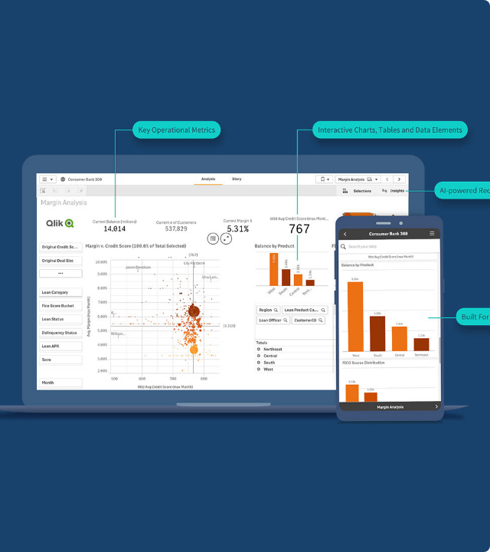
Deep-Dive Fund Analytics
Improved drill-down view for researchers to examine individual scheme holdings and concentration risks.
Portfolio Overlap: Detect redundancy between funds.
Risk Attribution: Decomposition of risk factors.
Rolling Returns: 3-yr and 5-yr consistency analysis.

Slide 11
Strategic Findings & Recommendations
Cost Efficiency Impact: Regular Plans with expense ratios < 0.8% outperform regular plans by 1.4% per annum on an average over 5-year horizon.
Volatility Correlation: Small-cap funds had a 0.92 correlation with market crashes but 1.5x recovery speed than Large-cap counterparts.
Strategic Recommendation: For wealth creation over the long-term, a core-satellite approach with 60% Index Funds and 40% Active Mid-cap funds is mathematically the best for the current market scenario.
Future Scope: Sentiment analysis of financial news to predict short term changes in NAV.

Slide 12
THANK YOU!
Bluestock MF Capstone Project Presentation

